Slide 1
Proposal of observation framework with HImawari-8 and GCOM-C for biomass burning monitoring. アジア域のバイオマスバーニングモニタリングに向けて
Koji Kajiwara, Yoshiaki Honda
Center for Environmental Remote Sensing, Chiba University

Slide 2
Fire Monitoring of the Asian region by Himawari-8 and GCOM-C
Drought detection of vegetation region by Water Stress Trend index (WSI)
・Land Cover data ：GCOMーC Product
・Solar radiation data：H8 product developed by Dr.Takenaka JAXA/EORC
・Detecting fire region using high frequency time series TIR data / precise geometric corrected data.
HotSpotDetection
Improve the GCOM-C algorithm for high-frequency time-series data of Himwari-8
Algorithm is verified by the pasture filtrate forest area of Australia.
High-frequency time-series data should be processed in Japan-side server.
The product of EW and/or fire maps will be distributed to Asian countries.

Slide 3
Possibility of Hot Spot detection by high-frequency time series. Forest fire inJava Sept. 2015
2015.9.11 VIS image
Notes:
CEReSが提供した画像から毎日新聞の「ひまわりEye」に掲載された可視画像

Slide 4
Forest fire inJava Sept. 2015
2015.9.11 VIS image
2015.9.11 TIR image（Band13)
We can see the Hot Spot that does not move from the gap of the cloud.
（Using a precision geometry corrected grid data）
Notes:
Band 13 (10.4 μm)の輝度温度から （273.15K以下をカットした画像）

Slide 5
Forest fire inJava Sept. 2015 (animation video)
We can see the Hot Spot that does not move from the gap of the cloud.
（Using a precision geometry corrected grid data）

Slide 6
Forest fire of 25 Dec. 2015, Lorne, Austraria
https://www.rt.com/news/327125-bushfires-australia-tourist-area/

Slide 7
Forest fire of 25 Dec. 2015, Lorne, Austraria

Slide 8
2015年９月のジャワ島森林火災
Notes:
以下１０枚はビデオ再生ができない場合の予備

Slide 9
2015年９月のジャワ島森林火災

Slide 10
2015年９月のジャワ島森林火災

Slide 11
2015年９月のジャワ島森林火災

Slide 12
2015年９月のジャワ島森林火災

Slide 13
2015年９月のジャワ島森林火災

Slide 14
2015年９月のジャワ島森林火災

Slide 15
2015年９月のジャワ島森林火災

Slide 16
2015年９月のジャワ島森林火災

Slide 17
2015年９月のジャワ島森林火災

Slide 18
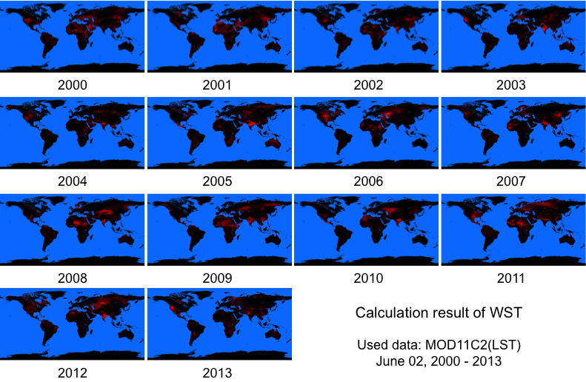
Water Stress Index of the GCOM-C algorithm.
WSI

Slide 19
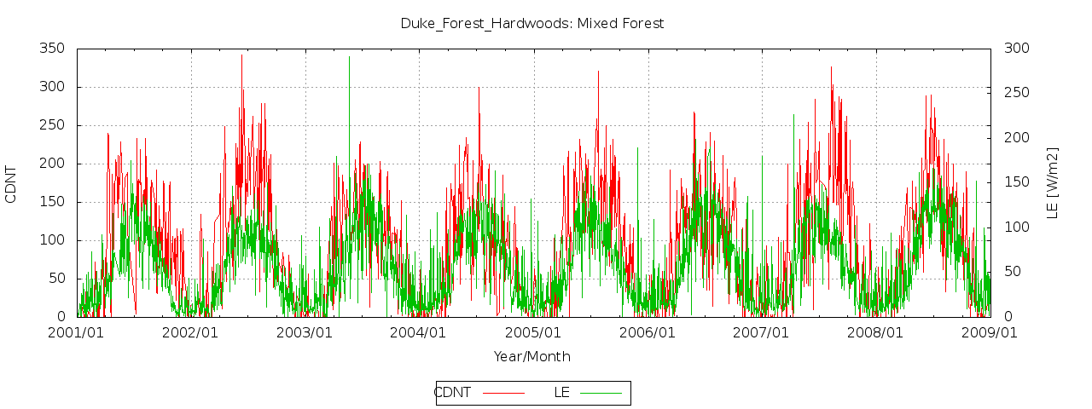
Water stress detection method
Compensated Day Night Temperature-difference
T_{day}: Daytime land surface temperature
T_{night}: Nighttime land surface temperature
(T_{night} – 273.15): When less than or equal to 0, the value is set to 0.
CDNT has closed relationship with latent heat flux.

Slide 20
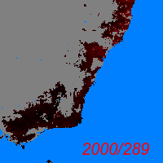
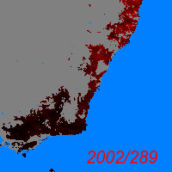
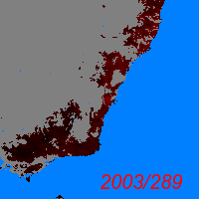
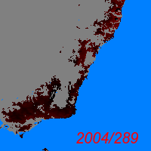
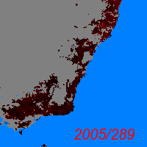
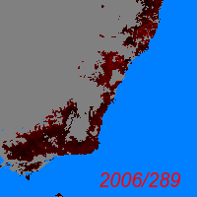
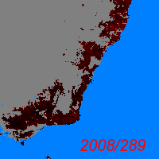
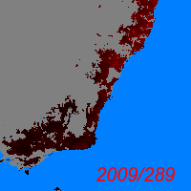
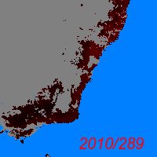
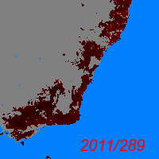
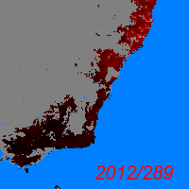
WSI of the forest area of southeastern Australia Coast of DOY 289. (using MOD11C2 ver. 005)

Slide 21
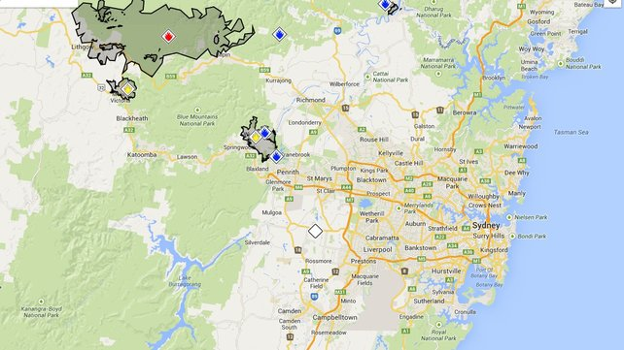
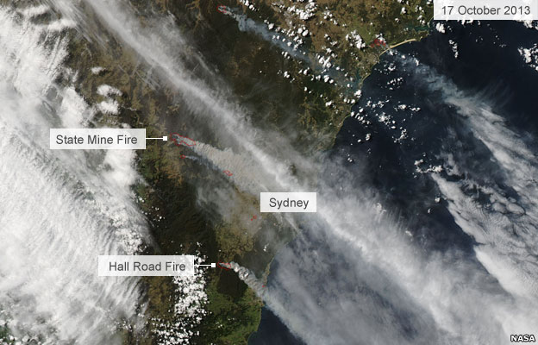
Drought in Australia
・2002-2003
・2006-2007
Large-scale forest fires of October 2013 in Sydney suburbs.
New south wales rural fire service map
MODIS True color image
17 Oct. 2013

Slide 22
Future development of the land Products by HImawari-8 and GCOM-C
Water Stress Index using a high-frequency Himawari-8 time series data.
with ...
・High frequency solar radiation data from H8
・GCOM-C Land Cover data
Early Warning information of forest fires in the Asian region due to drying.
High frequency
Precise geometric corrected VIS, TIR data product
Solar radiation data
LST product
and
Land Cover map（GCOM-C)
Biomass map（GCOM-C）
Crop yield estimation by the model assimilation using above products.

