Slide 1
Progress update on Land Application from Himawari-8
Australian Land Applications Working Group (with the exception of Session 2)

Slide 2
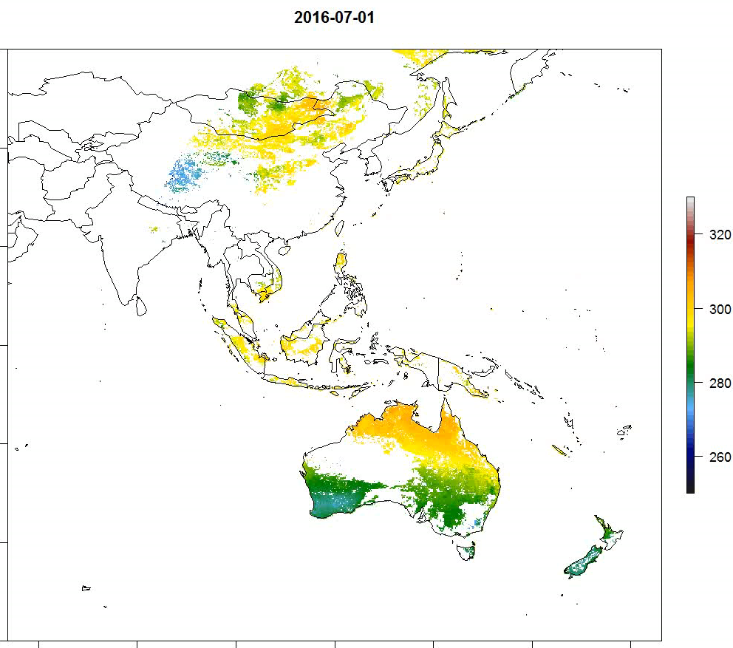
Land surface temperature retrievals
Luigi Renzullo (CSIRO), Leon Majewski (BoM), Peter Fearns (Curtin Uni.)
Aim: to implement and evaluate AHI LST retrievals and assess (i) performance against LEO satellites (e.g. MODIS, Landsat), (ii) accuracy required for surface energy balance studies (esp. evapotranspiration).
Work by Dr Yunyue Yu, NOAA, on evaluating many different Split Window Algs. (SWA’s) for ABI on GOES-R
Adapt recommended alg. for our holdings of Himawari-8 data. First attempts use:
  MODIS monthly average emissivity from 2015 (SeeBor, Seeman et al., 2008); and
  NOAA-NCEP Global Forecast System (GFS) Total Column Water Vapour (TCWV)

Slide 3
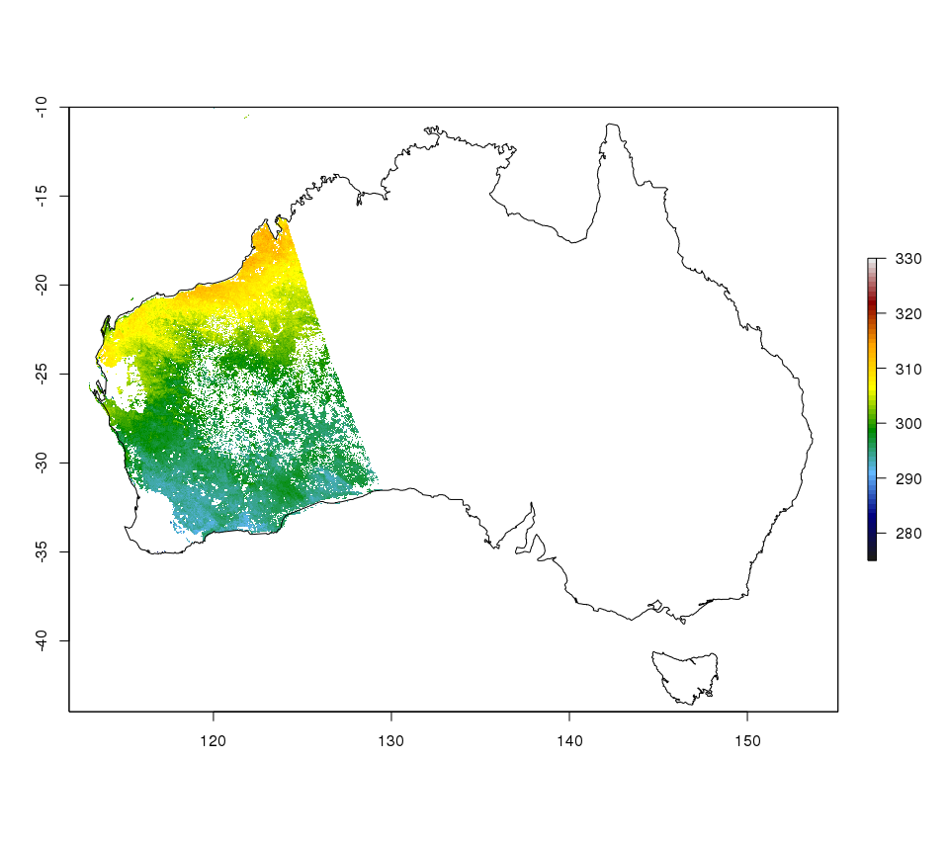
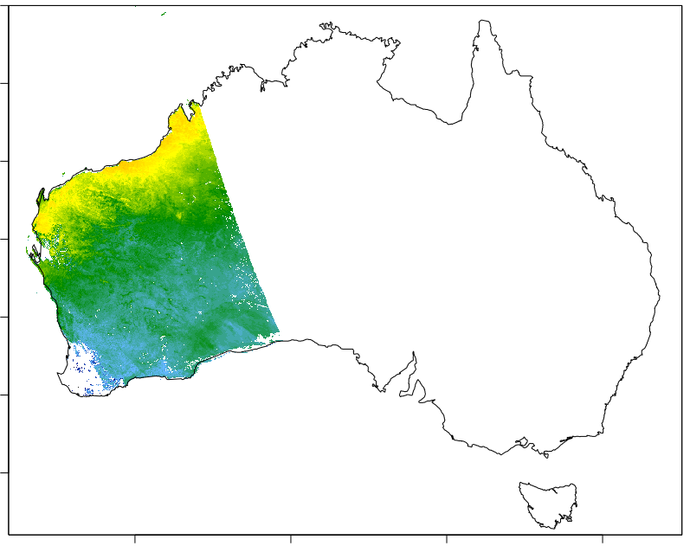
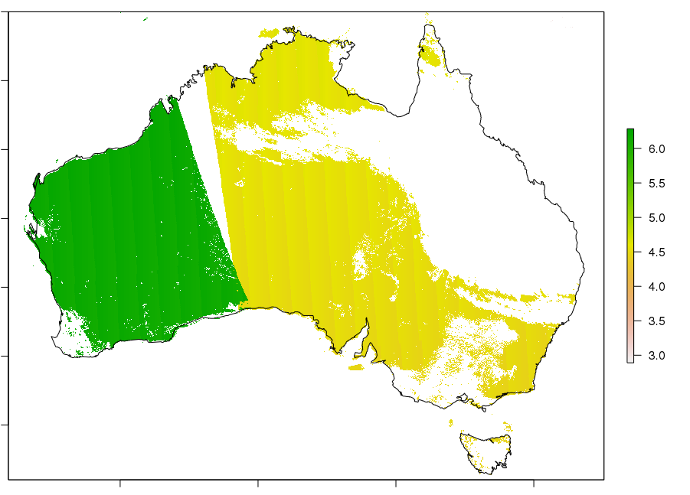
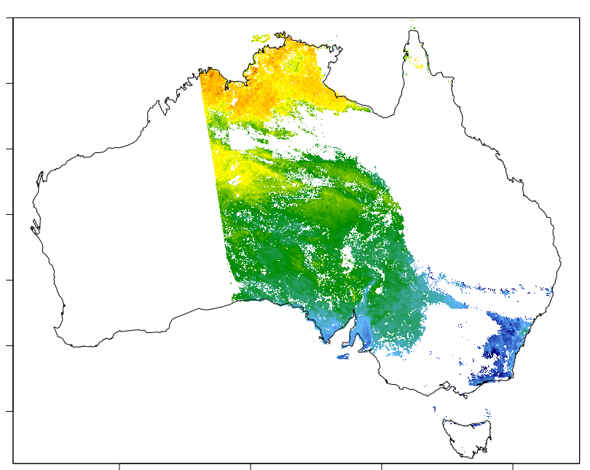
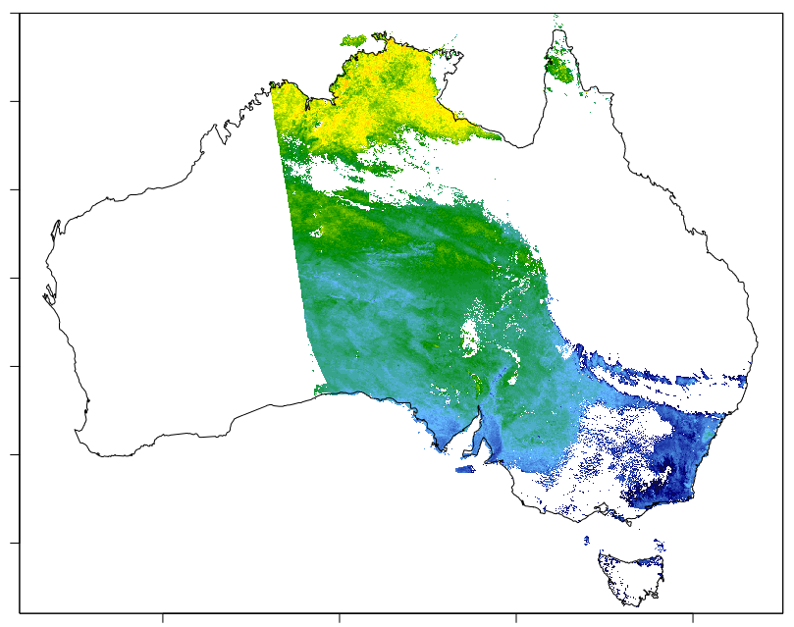
Land surface temperature retrievals
First evaluation of AHI LST against MODIS LST (MOD/MYD11A1) for Australia
H8 0620 UTC
Aqua LST_day
HR
(UTC)
LST (K)
H8 0430 UTC
Aqua LST_day

Slide 4
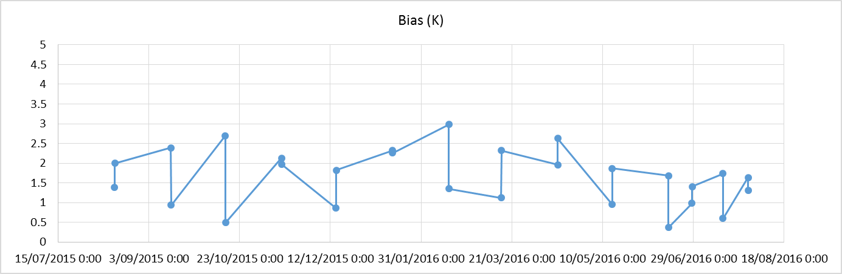
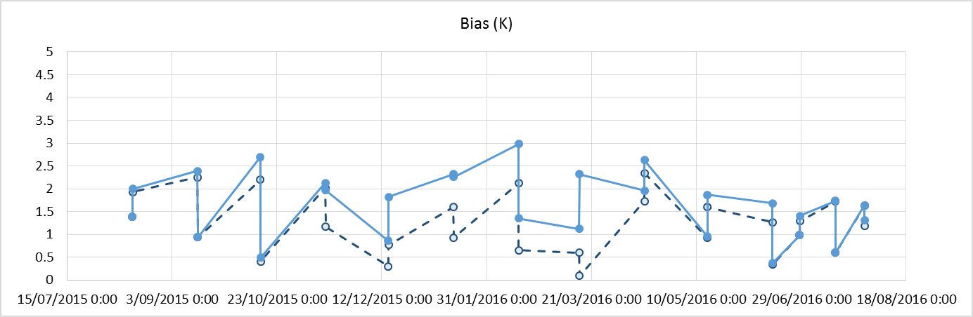
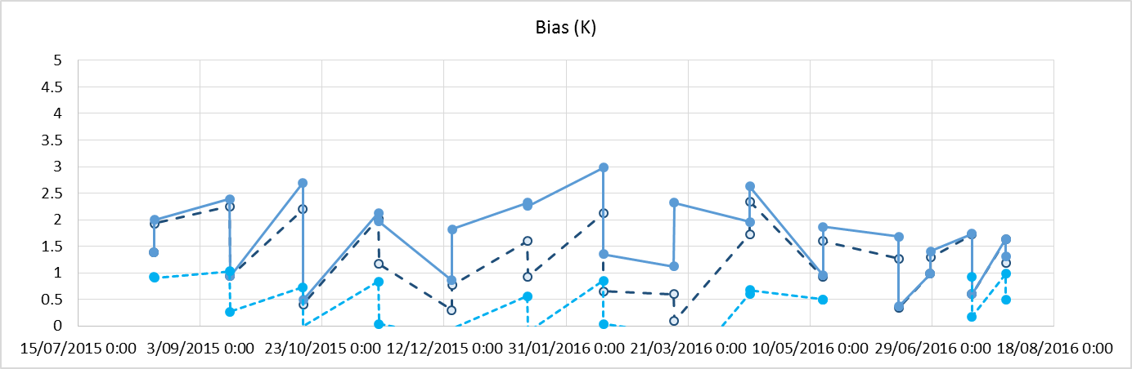
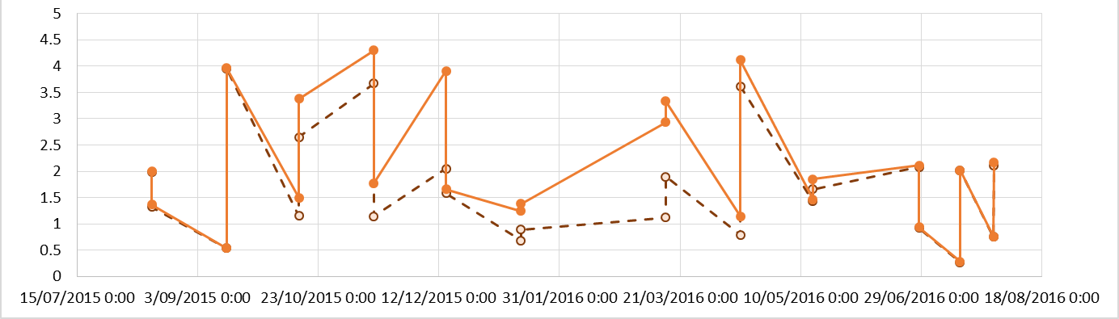
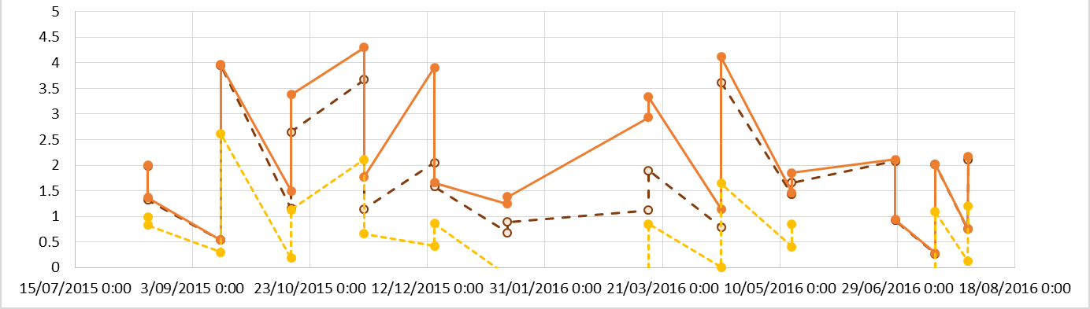
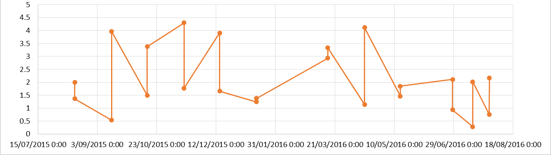
Land surface temperature retrievals
Bias = H8_LST - MODIS
TCWV + Monthly AV. Emis. from MODIS
Assume Dry atmos + Monthly AV. Emis. from MODIS
Aqua comparison
Assume Dry atmos + Daily. Emis. from MODIS
Terra comparison

Slide 5
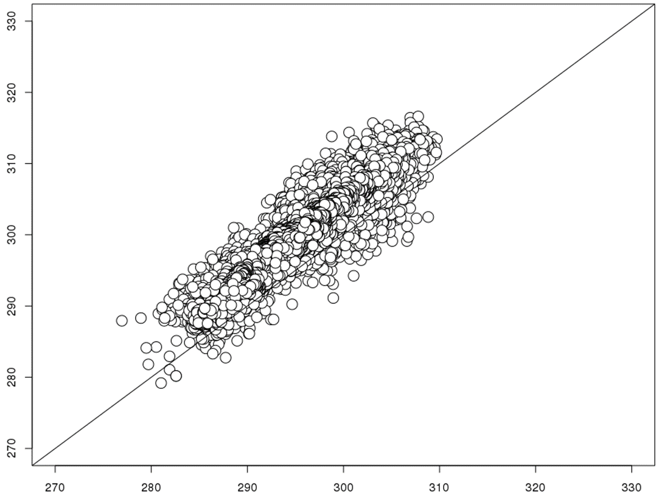
Land surface temperature retrievals
AHI_LST_0140UTC 2016-07-15 (K)
MOD11A1_LST_DAY 2016-07-15 (K)
GFS TWCV + MODIS mnth. av. Emis.
Dry atms. + MODIS mnth. av. Emis.
SURFRAD (Heidinger et al,. 2013, J Atms. Ocean. Res.)
Dry atms. + MODIS daily Emis.

Slide 6
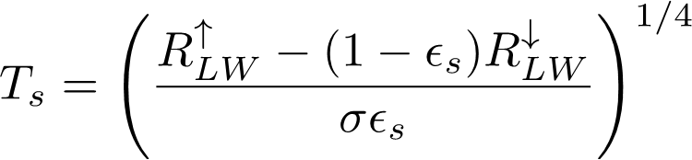
Land surface temperature retrievals
Some next steps:
    Investigate ACCESS TCWV as an option
    Explore alternatives for emissivity (incl. adaption of dynamic land cover classification approach)
    Evaluations to include flux tower data (OzFlux, AsiaFlux, Fluxnet?)
    Explore uses of cloud mask
Progress real collaboration with Japanese colleagues.
    Need to compare methods, data, results and conduct joint collaboration

Slide 7
Leaf Area Index & Leaf Angle Distribution
Xihan Mu (Beijing Normal Uni. China), Tim McVicar (CSIRO), Qin Yi (CSIRO), Luigi Renzullo (CSIRO)
Begun exploration of using visible channels from AHI to infer LAI and LAD
Exploiting the high observation frequency
use dense temporal observations to eliminate redundant variables & atm. Effect
LC map and other data provide clumping index, spectral information of endmembers, etc

